Slide 1
Digital Signal Processing(BEC-42)
Unit-2
Lecture-1
Approximation of Derivatives
Date:29/09/2020

Slide 2
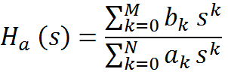





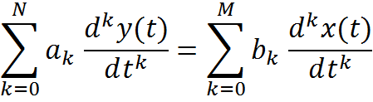


Infinite Impulse Response (IIR) Filter Design
The designing of an IIR filter involves design of a digital filter in analog domain and transforming the design into the digital domain.
The system function describing an analog filter may be given as
Where and are filter coefficients.
Impulse response of these coefficients is related to by Laplace transform
Analog fitter having rational system function can be described as
(s) =
Where denotes input signal and output signal of the filter

Slide 3
Recall that an analog filter with system function H(s) is stable if all its poles lie in the left-half of s-plane. So, if conversion technique is to be effective, it should posses the following properties
The jΩ axis in the s-plane should map into the unit circle in the z-plane. Direct relationship between the two frequency variables in two domain.
The left-half plane(LHP) of the s-plane should map into the inside of the unit circle in z-plane to convert a stable analog filter into a stable digital filter.
analog
digital
s-plane
z-plane
Problem: we need to map the derivative operator “s” into the time shift operator “z”, and make sure that the resulting system is still stable.

Slide 4


IIR Filter Design by Approximation of Derivatives
Approximate the above differential equation by an equivalent difference equation.
The backward difference formula is substituted for derivative at time t=nT .
Thus
Approximation of the differential operator:
Where T is sampling interval and y(n)=y(nT)
take the z-Transform of both sides:
approximation of “s”

Slide 5




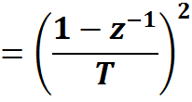
The second derivative of y(t) is now replaced by the second backward difference. This gives

Slide 6





The i^{th} derivative of y(t) results in the equivalent frequency relationship
As a result digital filter’s system function can be obtained by the approximation of derivatives as
Where is the system function of analog filter.
Where and Ω varies from - to

Slide 7
Drawback of Approximation:
It maps the whole stable region of the s-plane into a subset of the stable region in the z-plane
s-plane
z-plane
since
if Re[s]<0.
Suitable for only low-pass and band-pass filters having smaller resonant frequency.

Slide 8





It forward difference can be substituted for the derivative instead of the backward difference. This gives,
Im(z)
s-plane
z-plane
0
0
1
Re(z)
Worse situation than the backward difference substitution for the derivative.
Not always mapped into stable digital filter.

Slide 9
Example:
Consider a analog filter with transfer function and discretize it with a sampling frequency using approximation method.
Solution:
The filter is implemented by the difference equation

Slide 10
analog
digital
s-plane
z-plane

Slide 11

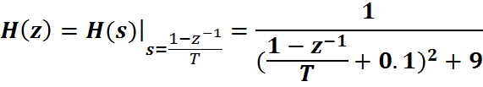
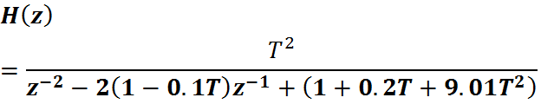
Example: An analog filter has the following system function, Convert the filter into digital filter using backward difference for the derivative.
Solution
The system function of digital filter is

Slide 12
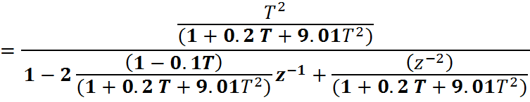

If T=1s,

